Slide 1
Bots & Conversations as a Platform
Name
Role
Microsoft Confidential

Slide 2
Agenda
Conversation as a Platform
Bot Overview
Creating your first bot
Connecting your bot with Connector Service
Understanding Bot State
Dialogs
LUIS – Understand tour user with NPL
Creating MultiDialogs
Simple orders with Form Flow
Turning the experience better: Resources
Improve with Speech
Turn your bot more intelligent with Cognitive Services

Slide 3

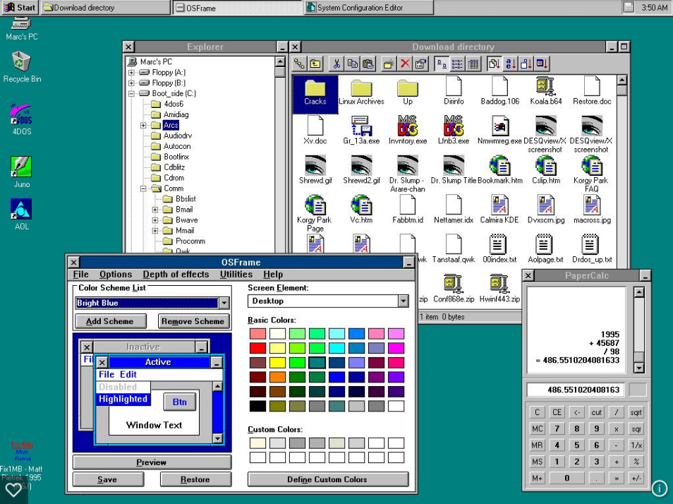
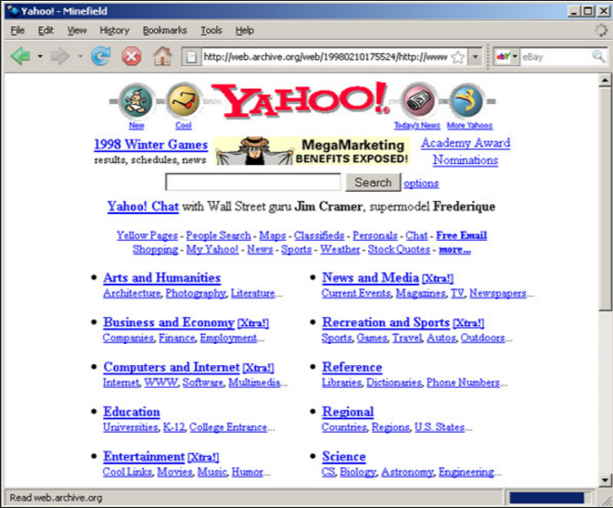
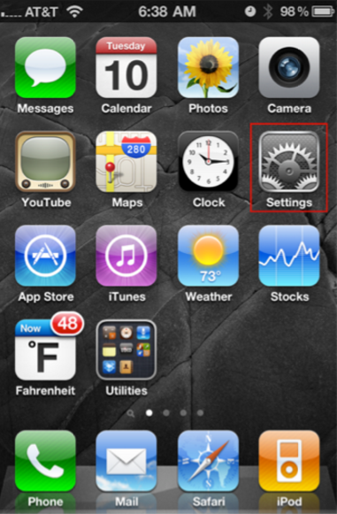
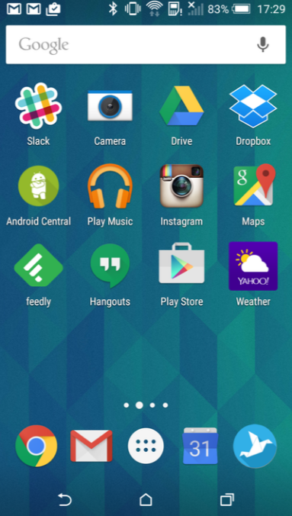
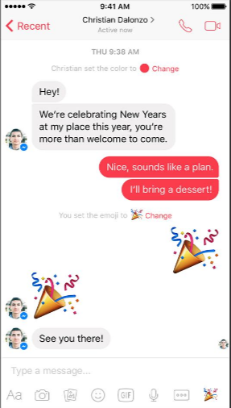
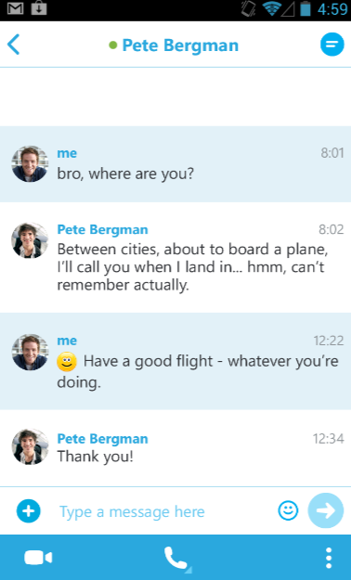
The world and technology are once again transforming
– Satya Nadella, CEO Microsoft
mid-80s
mid-90s
mid-00s
mid-10s
PC
Web
Smartphone
Messaging
Platform Examples
Desktop OS
Dos, Windows, Mac OS
Browser
Mosaic, Explorer, Netscape
Mobile OS
iOS, Android, WP
Messaging Apps
Whatsapp, WeChat, Skype
Application Examples
Programs
Excel, PPT, Lotus
Web Sites
Yahoo, Amazon
Apps
Angry Birds, Instagram
Bots / Agents
Weather, Travel
UI
GUI Apps
Web Pages
Native Apps
Conversations
Microsoft Confidential
Notes:
“The world and technology are once again transforming”
– Satya Nadella, CEO Microsoft
Use of Messaging apps surpassed Social apps in 2015
We want to take that power of human language and apply it more pervasively to all of the computing interface and the computing interactions through machine learning and AI.
CAAP:
Having the most natural enriched conversation with anyone -> Skype Translator (and other cognitive services)
Apply the same power of human conversation to everything else -> a personal digital assistant that know you and your world, and is always there to help you with your everyday tasks across all devices
Calling any application (as a bot) within a conversational canvas instead of looking at pages and pages of websites and apps
“And so you can conceptualize this platform where human language is the new UI layer. Bots are like new applications, and digital assistants are meta apps or like the new browsers. And intelligence is infused into all of your interactions. That’s the rich platform that we have.”
Articles:
https://chatbotbook.com/the-rise-of-intelligent-bots-e896cde7281b#.3xv2h6m48
https://chatbotsmagazine.com/chinas-wechat-foretells-facebook-microsoft-bot-platforms-future-278c3bd4bf14#.7jtideqdl
http://www.cnet.com/how-to/what-is-a-bot/#!
http://www.theverge.com/2016/3/30/11334000/microsoft-big-bots-bet
http://www.enterprise-security-today.com/news/Why-Should-We-Care-About-Bots-/story.xhtml?story_id=0110018ENHC3
http://www.marketplace.org/2016/04/11/tech/chat-bots

Slide 4
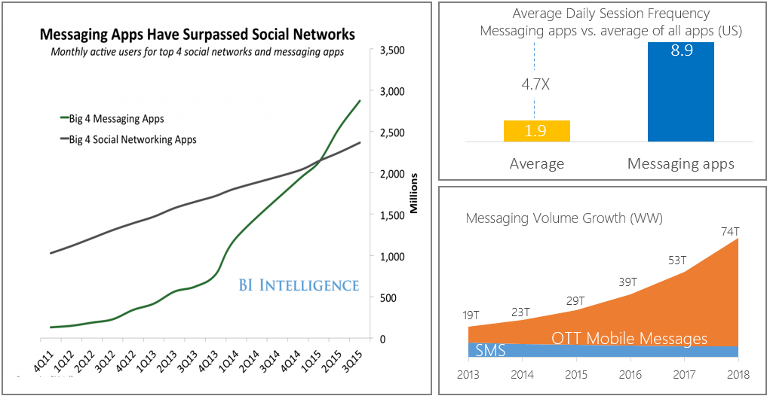
Conversations are the new platform of habit
Messaging apps experience explosive growth in terms of active users, frequency of use and messaging volume
Source: BI Intelligence, Portio Research
Microsoft Confidential

Slide 5
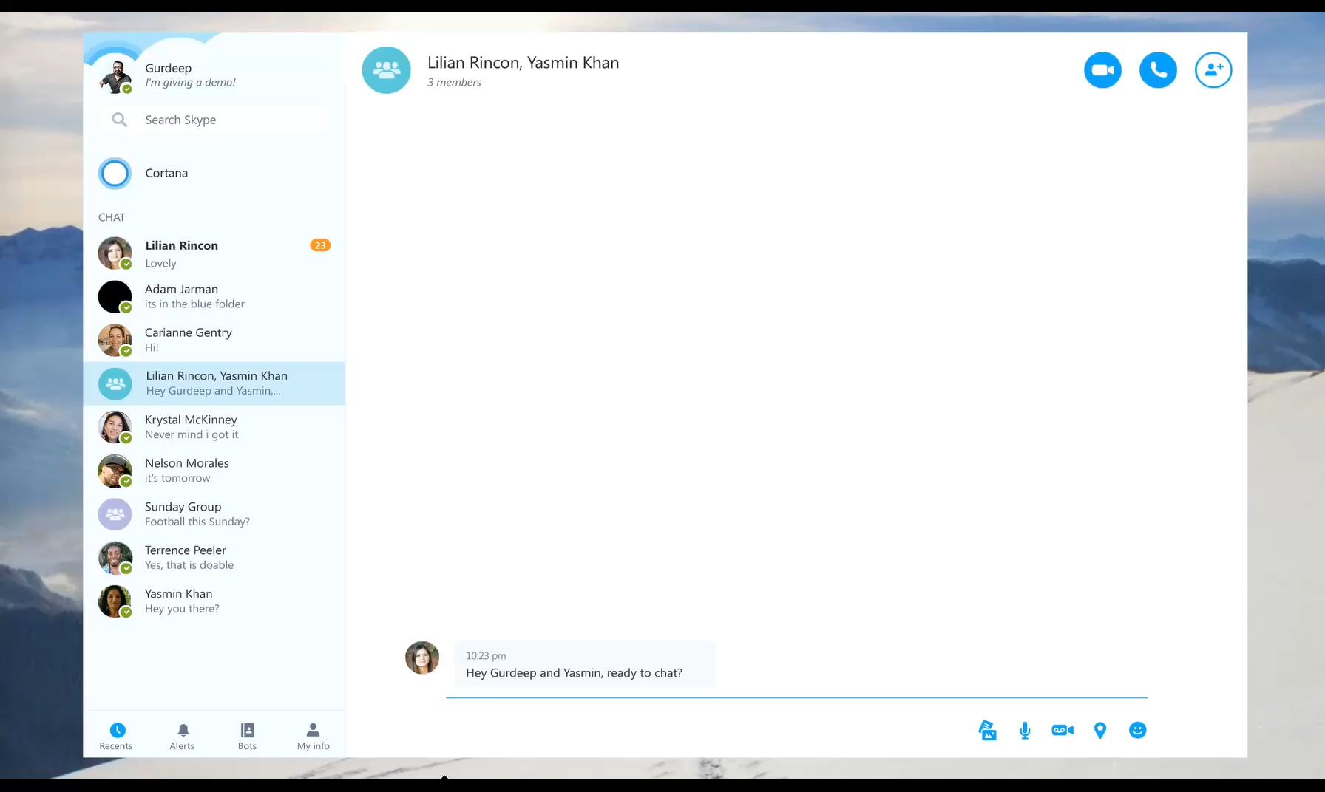
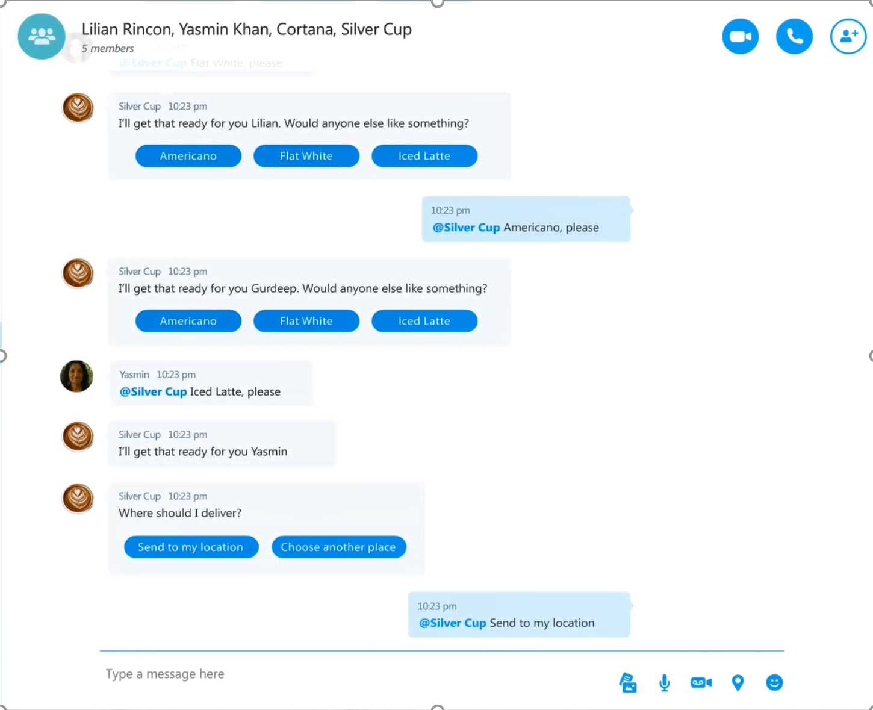
Bots represent a new channel for businesses
Reach customers anywhere, on any platform or device
Engage with customers in a natural way; conversationally and in context
Expose and monetize your products & services in messaging platforms
Improve customer experience and reduce the need for human assistance
Microsoft Confidential
Notes:
Data and device price decline
Engaging chat + content + services
5x growth over next 3 years
Young demographic
Higher retention & usage than apps
Opportunity for 1:1 connection
Monthly users of messaging apps surpassed
Social apps a year ago

Slide 6


Conversation as a Platform
A comprehensive platform of tools & services that can help you build your bot, provide your bot with smart capabilities and publish it wherever your users talk.
Microsoft Confidential

Slide 7
Microsoft is building the most comprehensive set of tools and services for building bots, making them smart, and publishing them across Skype & numerous other canvases.
Skype
Cognitive Services
Harness real-time audio, video, messaging and group messaging to engage customers on a familiar platform
Microsoft Bot Framework
Machine Learning APIs:
Vision, Speech, Language, Knowledge, Search, Translation
Your Brand
Bot Developer Portal, Bot Connector, Bot Directory
Your Products & Services | Your Personality
Microsoft Confidential
Notes:
Microsoft is investing in 3 key areas:
Creating the best cross-platform development tools for developers (Bot Framework) focused on developers, not a specific platform
A significant set of Artificial Intelligence “Cognitive Services” that are second to none in terms of the power they provide for developers
The richest canvas for bots

Slide 8
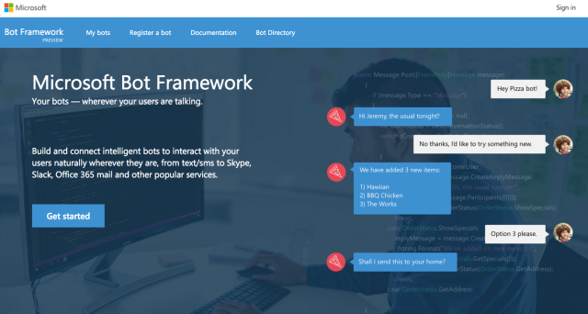
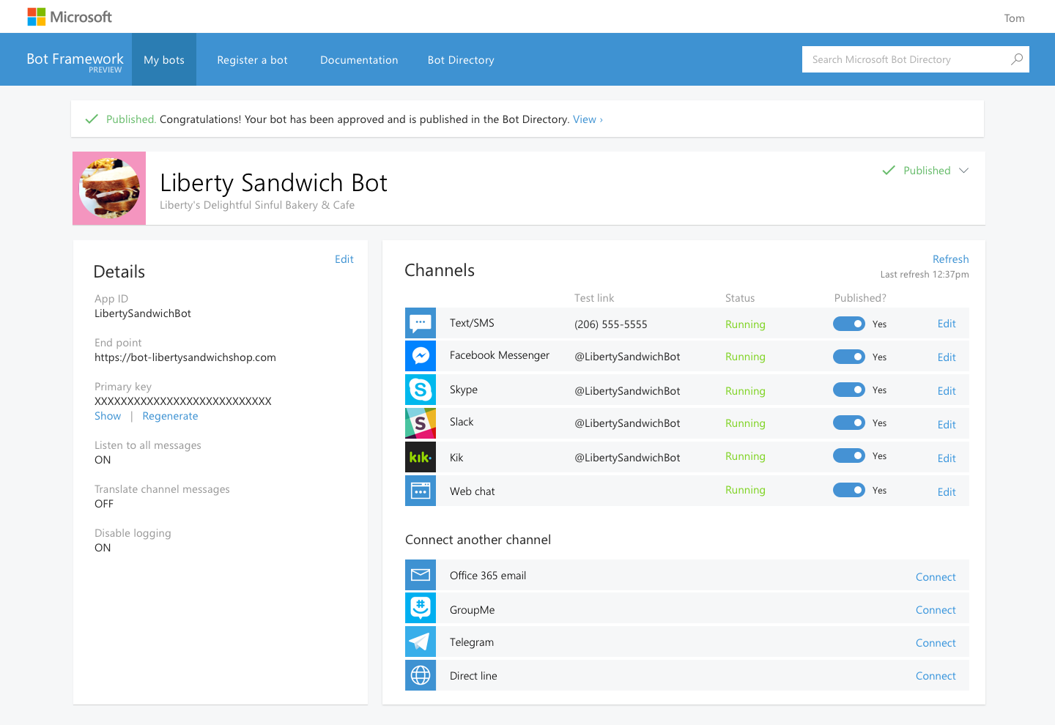
Bot Framework
Cognitive Services
Knowledge Cloud
Distribution Channels
Microsoft Bot Framework
Build once and publish your bots to the broadest set of channels your users are using
Bot Developer SDKs | Bot Connector | Bot Directory
Open source SDKs make it possible to bring your bot to life in minutes | Connect your bot to any or all of the top conversational experiences to reach >1B users | Make your bot discoverable via Bing, Cortana and other Microsoft surfaces
Microsoft Confidential

Slide 9


Microsoft Cognitive Services
Take advantage of the world’s premier AI technologies
Vision
From faces to feelings, allow your bots to understand images, videos & emotions
Speech
Convert speech-to-text and back again; understand intent, translate languages, filter noise and identify speakers
Language
Teach your bots to understand natural language commands, parse complex text and detect user sentiment
Knowledge
Incorporate rich knowledge amassed from the web, academia, or your own data
Search
Access billions of web pages, images, videos, and news with the power of Bing APIs
Notes:
What are Cognitive Services? Microsoft Cognitive Services are a new collection of intelligence and knowledge APIs that enable developers to ultimately build smarter apps.
Vision
Computer Vision API: Distill actionable information from images
Emotion API: Personalize experiences with emotion recognition
Face API: Detect, identify, analyze, organize, and tag faces in photos
Video API: Analyze, edit, and process videos within your app
Speech
Bing Speech API: Convert speech to text and back again, and understand its intent
Custom Recognition Intelligent Service (CRIS): Fine-tune speech recognition for anyone, anywhere
Speaker Recognition API: Give your app the ability to know who’s talking
Language:
Bing Spell Check API: Detect and correct spelling mistakes within your app
Language Understanding Intelligent Service (LUIS): Teach your apps to understand commands from your users
Linguistic Analysis API: Easily parse complex text with language analysis
Text Analytics API: Detect sentiment, key phrases, topics, and language from your text
Web Language Model API: Leverage the power of language models trained on web-scale data
Knowledge
Academic Knowledge API: Explore relationships among academic papers, journals, and authors
Entity Linking Intelligence Service: Contextually extend knowledge of people, locations, and events
Knowledge Exploration Service: Add interactive search over structured data to your project
Recommendations API: Provide personalized product recommendations for your customers
Search:
Bing Autosuggest API: Give your app intelligent autosuggest options for searches
Bing Image Search API: Bing advanced image and metadata search to your app.
Bing News Search API: Link your users to robust and timeline news searches
Bing Video Search API: Trending videos, detailed metadata, and rich results
Bing Web Search: Connect powerful search to your apps

Slide 10


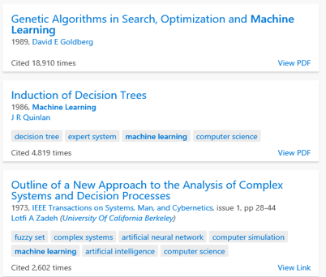

Microsoft Cognitive Services
Vision
Speech
Language
Knowledge
Search
PlayEpisode
What is in the image?
Give me directions to Space Needle
Play today’s Daily Show
Top publications in AI?
Search for ‘cute kittens’
Computer Vision
Speech-to-Text and Text-to-Speech Service
Natural Language Processing
Knowledge Exploration Service
Bing Search
Here are the top results:
Here is what I found:
Intent: PlayEpisode
Content: Daily Show
DateTime.date: today
Category | People; 1 face
Adult / Racy? | False / True
Dominant colors
Accent color
Convert text to spoken audio
Convert spoken audio to text
Extract intent of user
Microsoft Confidential
Notes:
Vision
Computer Vision API: Distill actionable information from images
Emotion API: Personalize experiences with emotion recognition
Face API: Detect, identify, analyze, organize, and tag faces in photos
Video API: Analyze, edit, and process videos within your app
Speech
Bing Speech API: Convert speech to text and back again, and understand its intent
Custom Recognition Intelligent Service (CRIS): Fine-tune speech recognition for anyone, anywhere
Speaker Recognition API: Give your app the ability to know who’s talking
Language:
Bing Spell Check API: Detect and correct spelling mistakes within your app
Language Understanding Intelligent Service (LUIS): Teach your apps to understand commands from your users
Linguistic Analysis API: Easily parse complex text with language analysis
Text Analytics API: Detect sentiment, key phrases, topics, and language from your text
Web Language Model API: Leverage the power of language models trained on web-scale data
Knowledge
Academic Knowledge API: Explore relationships among academic papers, journals, and authors
Entity Linking Intelligence Service: Contextually extend knowledge of people, locations, and events
Knowledge Exploration Service: Add interactive search over structured data to your project
Recommendations API: Provide personalized product recommendations for your customers
Search:
Bing Autosuggest API: Give your app intelligent autosuggest options for searches
Bing Image Search API: Bing advanced image and metadata search to your app.
Bing News Search API: Link your users to robust and timeline news searches
Bing Video Search API: Trending videos, detailed metadata, and rich results
Bing Web Search: Connect powerful search to your apps

Slide 11
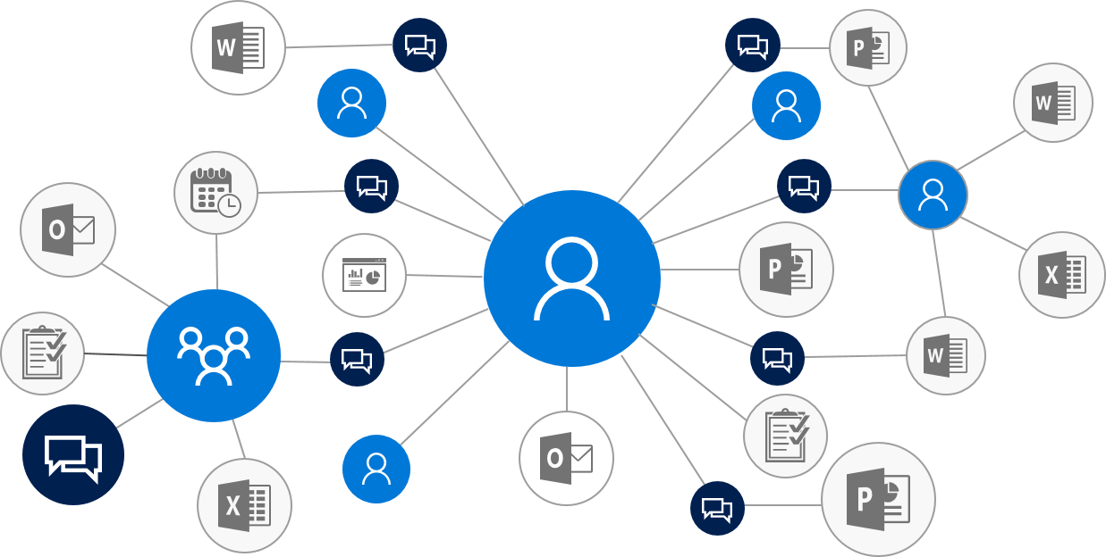
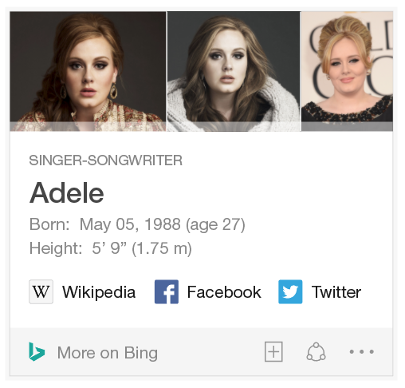
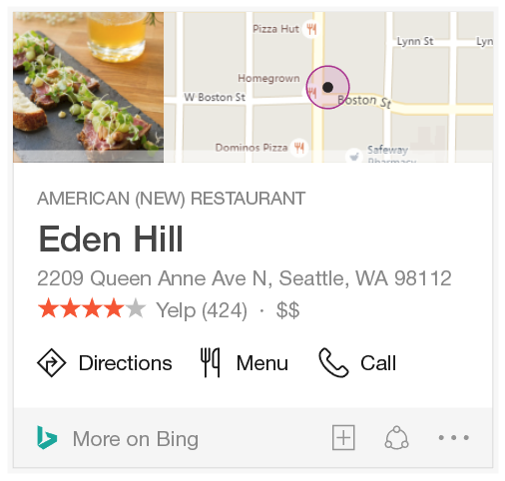

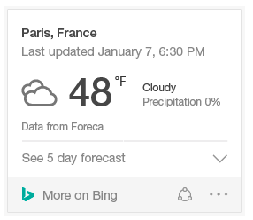
Bot Framework
Cognitive Services
Knowledge Cloud
Distribution Channels
Microsoft Knowledge Cloud
Tap into vast information, facts & actions on people, places and things from the web or your circle
Web Knowledge Graph
Office Graph (home, school, or work)
Entities
People, places and things
Local
Businesses, schools, Dr.
Answer
Weather, scores, events
2B Entities
31B Facts
9.7B Relationships
Profile
Mail
People
Photos
Files
Calendar
Directory
Tasks
Notes
Used by 85% of Fortune 500 Companies
Microsoft Confidential
Notes:
Vision
Computer Vision API: Distill actionable information from images
Emotion API: Personalize experiences with emotion recognition
Face API: Detect, identify, analyze, organize, and tag faces in photos
Video API: Analyze, edit, and process videos within your app
Speech
Bing Speech API: Convert speech to text and back again, and understand its intent
Custom Recognition Intelligent Service (CRIS): Fine-tune speech recognition for anyone, anywhere
Speaker Recognition API: Give your app the ability to know who’s talking
Language:
Bing Spell Check API: Detect and correct spelling mistakes within your app
Language Understanding Intelligent Service (LUIS): Teach your apps to understand commands from your users
Linguistic Analysis API: Easily parse complex text with language analysis
Text Analytics API: Detect sentiment, key phrases, topics, and language from your text
Web Language Model API: Leverage the power of language models trained on web-scale data
Knowledge
Academic Knowledge API: Explore relationships among academic papers, journals, and authors
Entity Linking Intelligence Service: Contextually extend knowledge of people, locations, and events
Knowledge Exploration Service: Add interactive search over structured data to your project
Recommendations API: Provide personalized product recommendations for your customers
Search:
Bing Autosuggest API: Give your app intelligent autosuggest options for searches
Bing Image Search API: Bing advanced image and metadata search to your app.
Bing News Search API: Link your users to robust and timeline news searches
Bing Video Search API: Trending videos, detailed metadata, and rich results
Bing Web Search: Connect powerful search to your apps

Slide 12


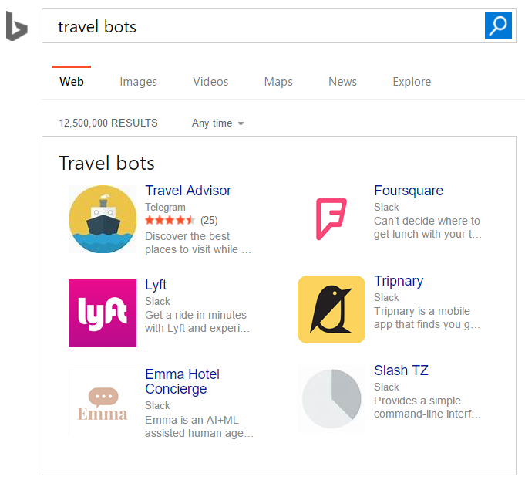
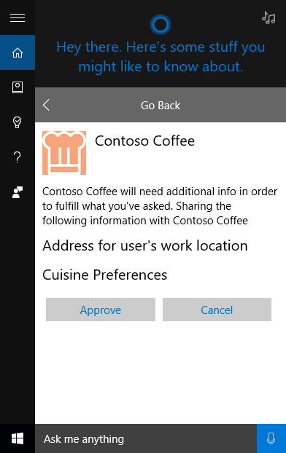

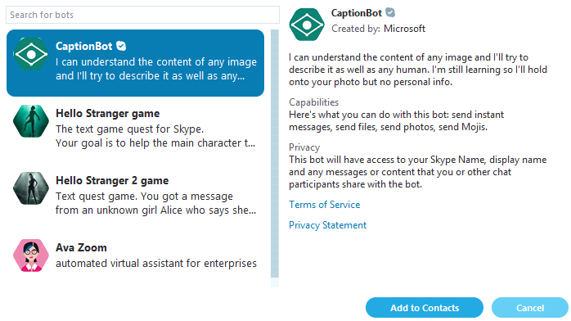
Bot Framework
Cognitive Services
Knowledge Cloud
Distribution Channels
Microsoft Bot Distribution Channels
Make your Bot Discoverable to > 1 Billion Users through Bing, Cortana, Skype and more
400 Million Monthly Active Users
300 Million Monthly Active Users
300 Million Monthly Active Users
+
+
+
Microsoft Confidential
Notes:
Vision
Computer Vision API: Distill actionable information from images
Emotion API: Personalize experiences with emotion recognition
Face API: Detect, identify, analyze, organize, and tag faces in photos
Video API: Analyze, edit, and process videos within your app
Speech
Bing Speech API: Convert speech to text and back again, and understand its intent
Custom Recognition Intelligent Service (CRIS): Fine-tune speech recognition for anyone, anywhere
Speaker Recognition API: Give your app the ability to know who’s talking
Language:
Bing Spell Check API: Detect and correct spelling mistakes within your app
Language Understanding Intelligent Service (LUIS): Teach your apps to understand commands from your users
Linguistic Analysis API: Easily parse complex text with language analysis
Text Analytics API: Detect sentiment, key phrases, topics, and language from your text
Web Language Model API: Leverage the power of language models trained on web-scale data
Knowledge
Academic Knowledge API: Explore relationships among academic papers, journals, and authors
Entity Linking Intelligence Service: Contextually extend knowledge of people, locations, and events
Knowledge Exploration Service: Add interactive search over structured data to your project
Recommendations API: Provide personalized product recommendations for your customers
Search:
Bing Autosuggest API: Give your app intelligent autosuggest options for searches
Bing Image Search API: Bing advanced image and metadata search to your app.
Bing News Search API: Link your users to robust and timeline news searches
Bing Video Search API: Trending videos, detailed metadata, and rich results
Bing Web Search: Connect powerful search to your apps

Slide 13
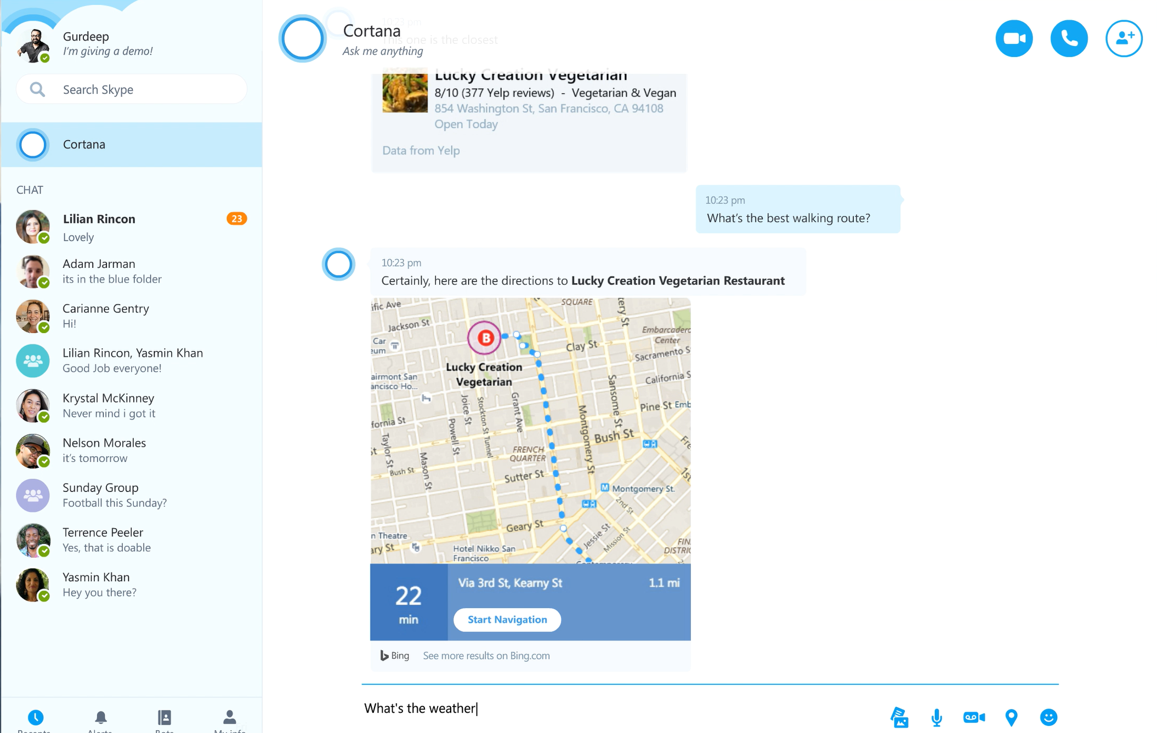

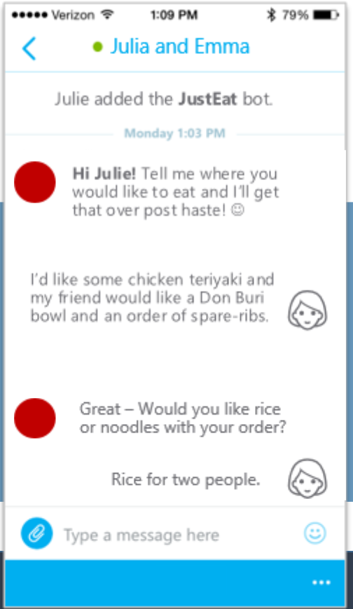
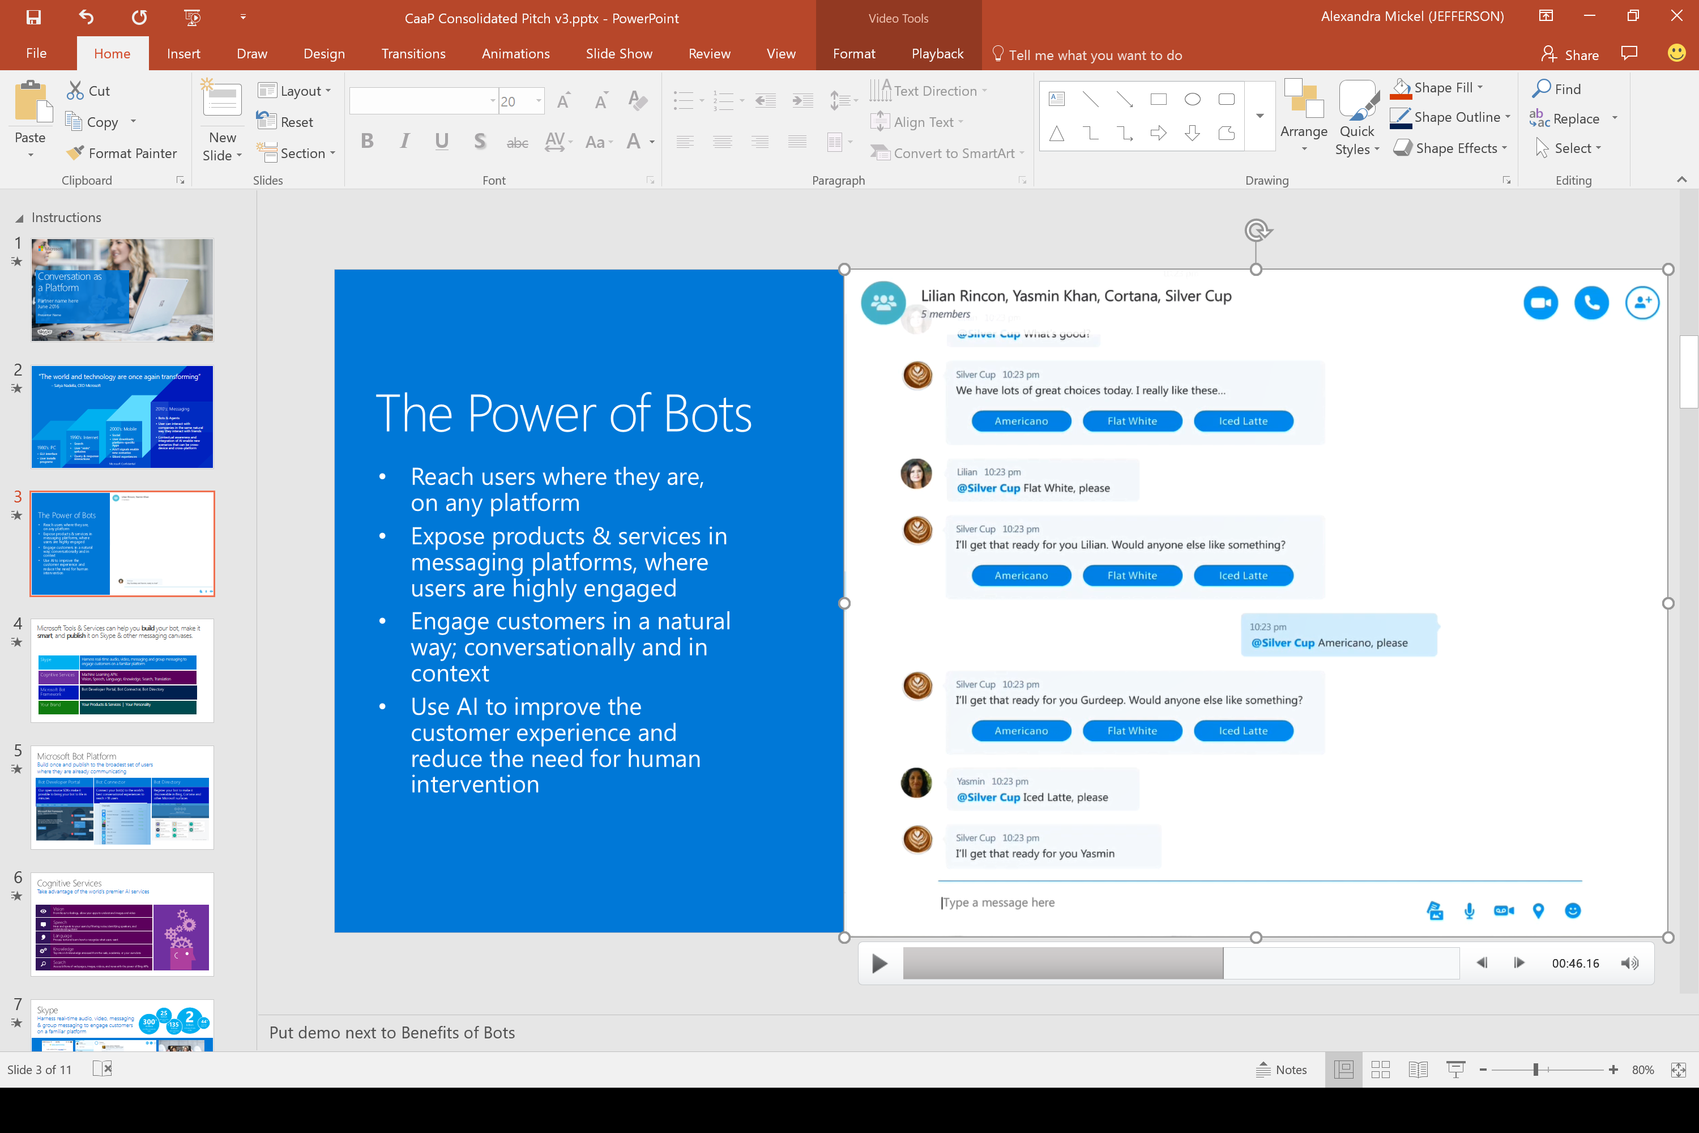

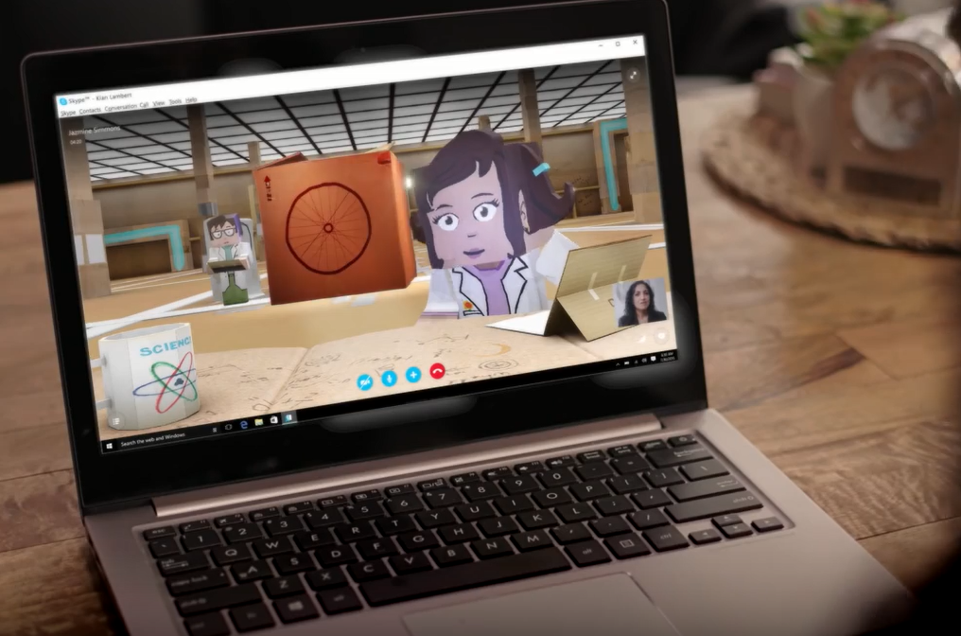
Bot Framework
Cognitive Services
Knowledge Cloud
Distribution Channels
Skype as a Premium Messaging Canvas
Group messaging and audio & video interaction models make it possible to engage customers in exciting new ways
Foodie
Silver Cup
Silver Cup
Microsoft Confidential
Notes:
Vision
Computer Vision API: Distill actionable information from images
Emotion API: Personalize experiences with emotion recognition
Face API: Detect, identify, analyze, organize, and tag faces in photos
Video API: Analyze, edit, and process videos within your app
Speech
Bing Speech API: Convert speech to text and back again, and understand its intent
Custom Recognition Intelligent Service (CRIS): Fine-tune speech recognition for anyone, anywhere
Speaker Recognition API: Give your app the ability to know who’s talking
Language:
Bing Spell Check API: Detect and correct spelling mistakes within your app
Language Understanding Intelligent Service (LUIS): Teach your apps to understand commands from your users
Linguistic Analysis API: Easily parse complex text with language analysis
Text Analytics API: Detect sentiment, key phrases, topics, and language from your text
Web Language Model API: Leverage the power of language models trained on web-scale data
Knowledge
Academic Knowledge API: Explore relationships among academic papers, journals, and authors
Entity Linking Intelligence Service: Contextually extend knowledge of people, locations, and events
Knowledge Exploration Service: Add interactive search over structured data to your project
Recommendations API: Provide personalized product recommendations for your customers
Search:
Bing Autosuggest API: Give your app intelligent autosuggest options for searches
Bing Image Search API: Bing advanced image and metadata search to your app.
Bing News Search API: Link your users to robust and timeline news searches
Bing Video Search API: Trending videos, detailed metadata, and rich results
Bing Web Search: Connect powerful search to your apps

Slide 14

Skype Bots Vision Demo Bots Vision Demo
Fans can have a real-time 2-way video conversation with character agents over Skype
Coming Soon
This enables a completely new way to interact with characters that fans already know and love.
Coming soon: talk to brands and characters face-to-face on Skype
Fans can Escape to another world or create a deeper engagement with their favorite character or brand
Microsoft Confidential

Slide 15
Demos
Microsoft Confidential

Slide 16
Thank you!
Microsoft Confidential

Slide 18
Appendix
Microsoft Confidential

Slide 19
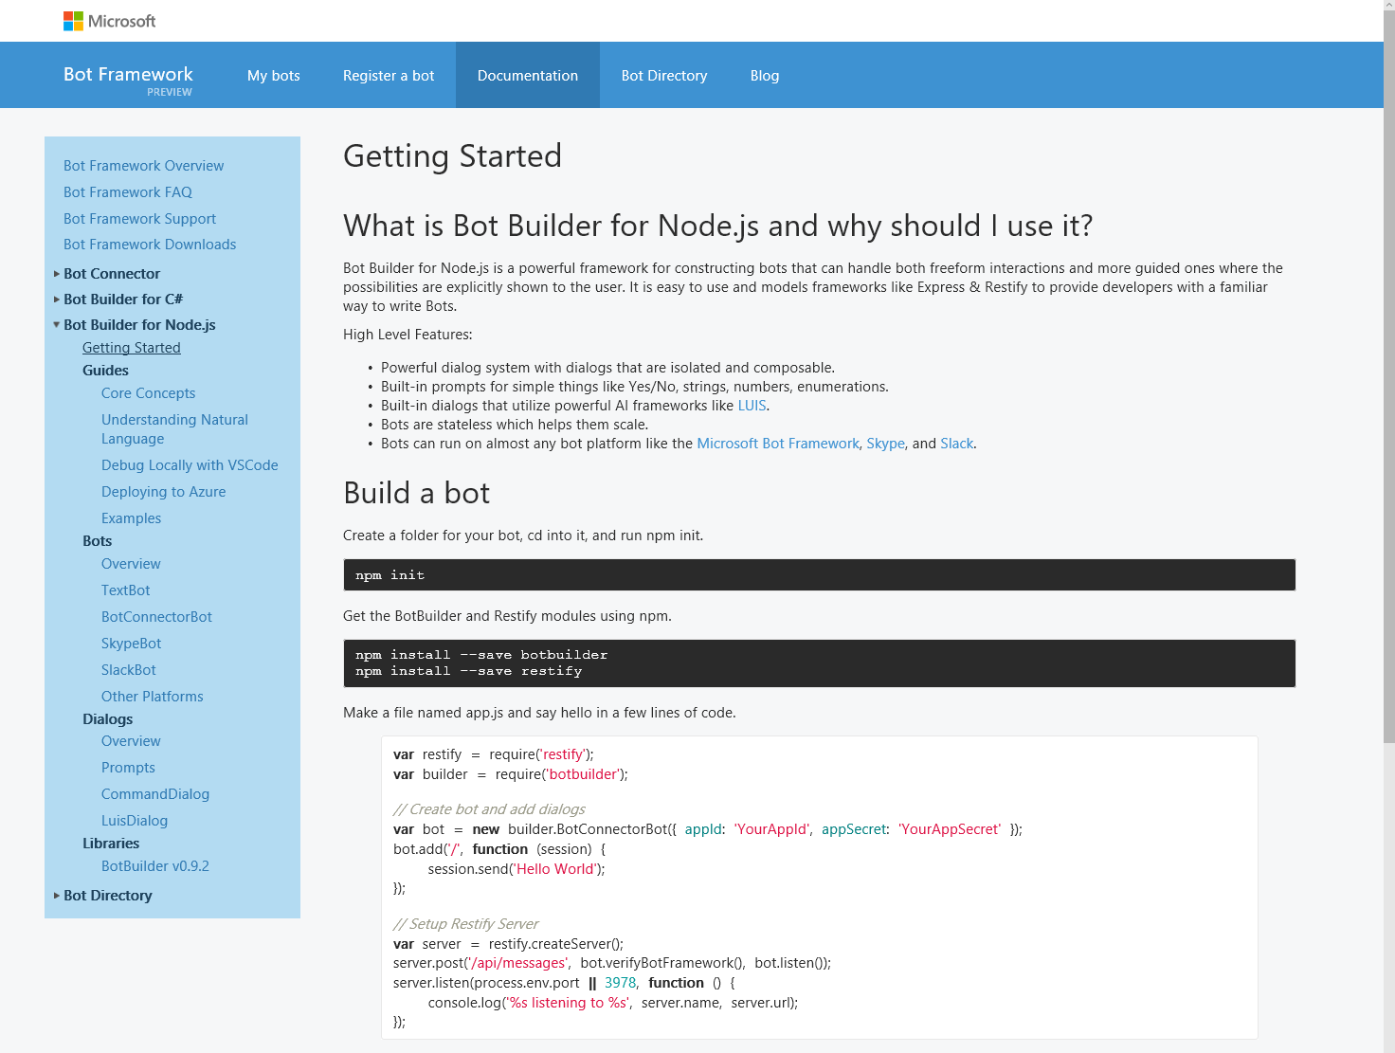
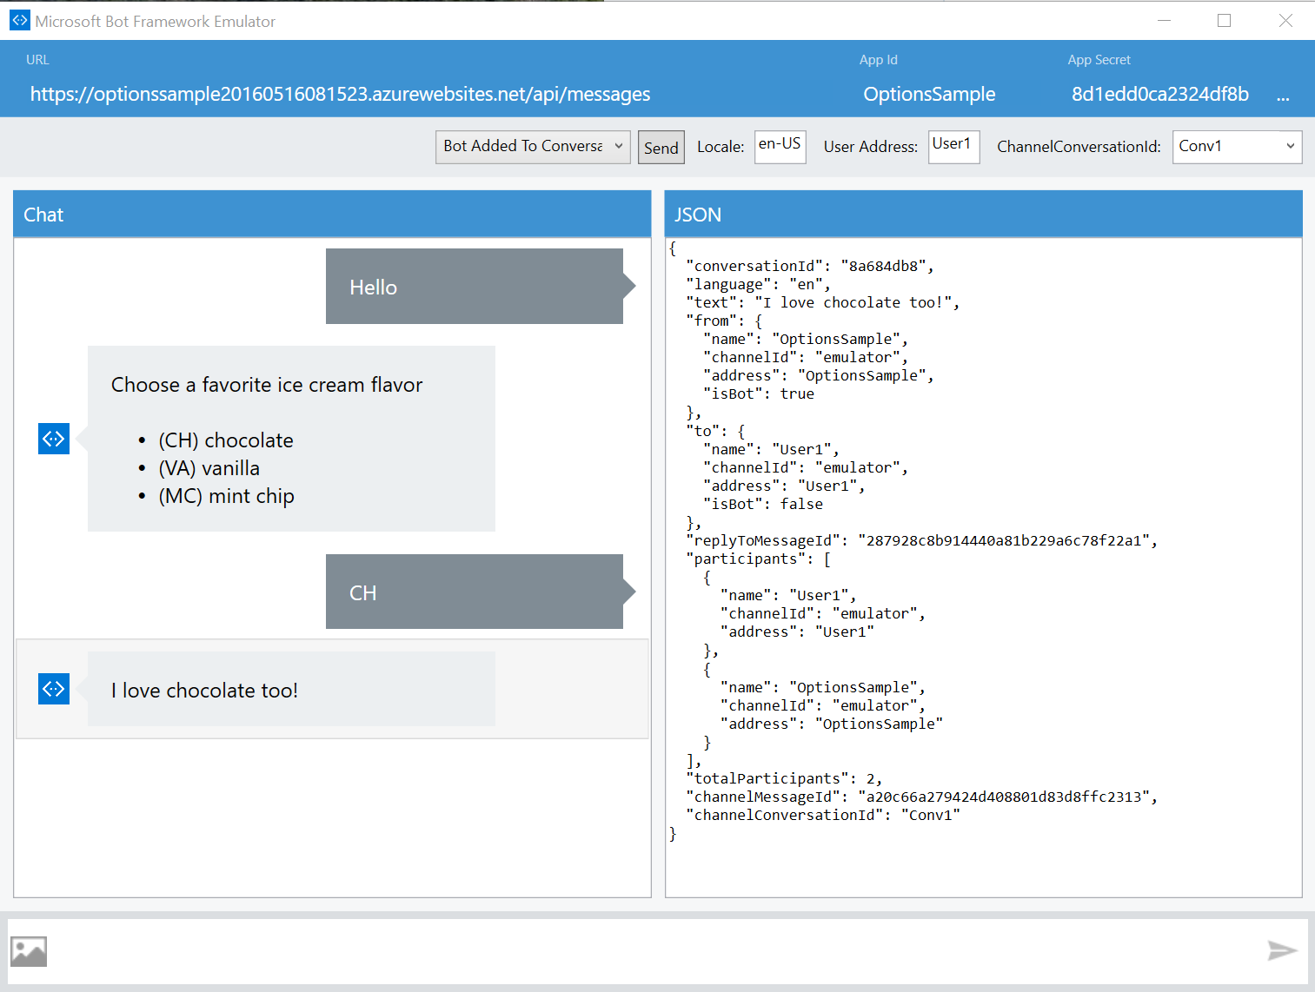
Bot Framework
Cognitive Services
Knowledge Cloud
Distribution Channels
Bot Development Tools
Build your bot with the best-in-class tools and services for bot development
Register and Manage your Bot
Build your Bot with the Bot Builder SDK
Test your Bot with the Bot Emulator
Deploy to Azure or other Cloud Service
Access Open Source Code and Guides
Microsoft Confidential

Slide 20
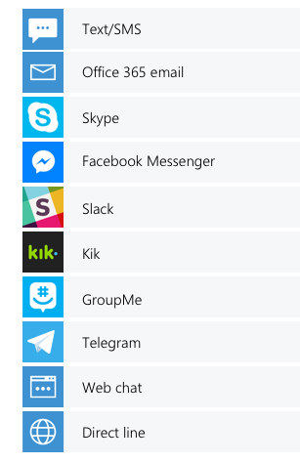
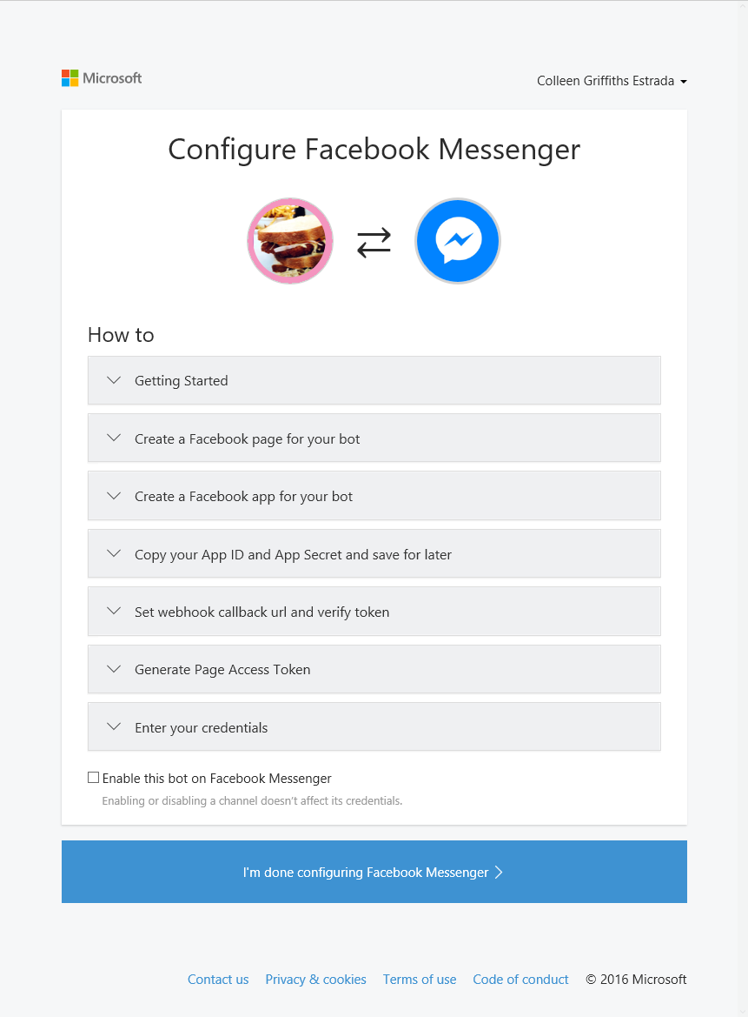
Bot Framework
Cognitive Services
Knowledge Cloud
Distribution Channels
Bot Connector
Connect your bot to the most popular messaging channels, including SMS/MMS and E-mail
Publish to 10+ Major Channels
Manage Channel Configuration
Use Built-in Interfaces for Channel I/O
Analyze Usage by Channel
Microsoft Confidential

Slide 21
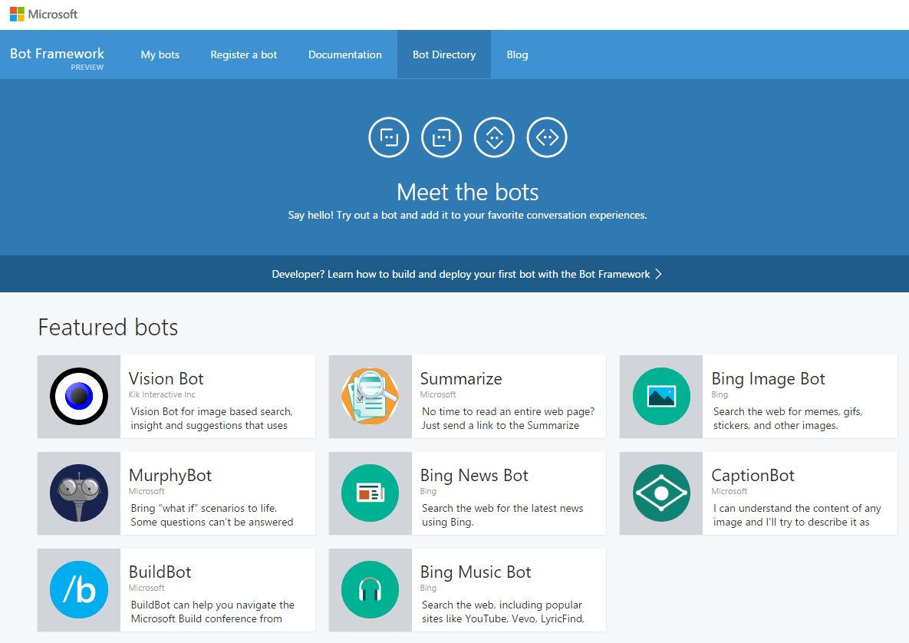

Bot Framework
Cognitive Services
Knowledge Cloud
Distribution Channels
Bot Directory
Make your bot discoverable to other users in Bing, Cortana, Skype and other Microsoft channels
Publish your Bot to the MS Directory
Expose your Bot through the MS Distribution Channels (Bing, Skype, etc.)
Connect your Bot to Cortana
Microsoft Confidential

